Slide 1
Foundations of
Dental Business
Systemization is Key

Slide 2

“We don't rise to the level of our expectations, we fall to the level of our training.”
Jocko Willink, Navy SEAL, Best-Selling Author

Slide 3
KPIs →
Systemization →
+profit/-stress

Slide 4
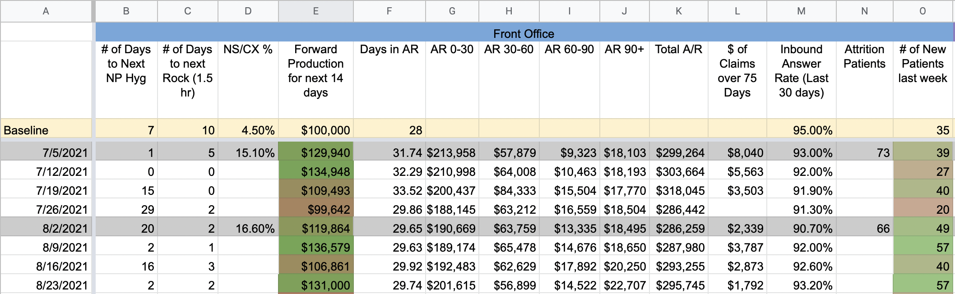
The Big Numbers

Slide 5




Days to Next ______
LEADING INDICATOR
EVALUATES HOW FAR OUT YOU ARE BOOKED
HOW FULL IS HYGIENE SCHEDULE
HOW FULL IS DOCTOR SCHEDULE

Slide 6


Forward 14 Day Production
Expected Production in the next 2 weeks
Gives a good indicator of future collections

Slide 7
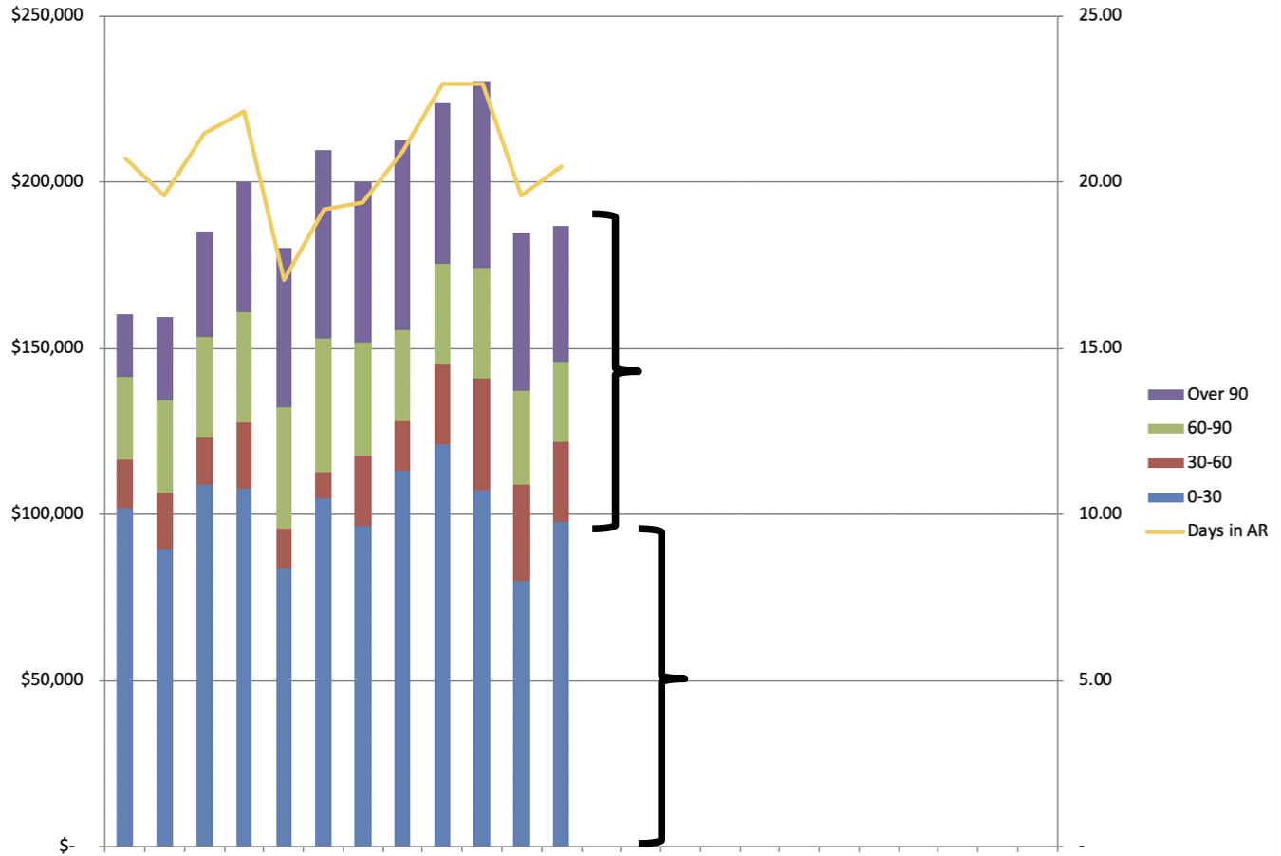
Accounts Receivable

Slide 8
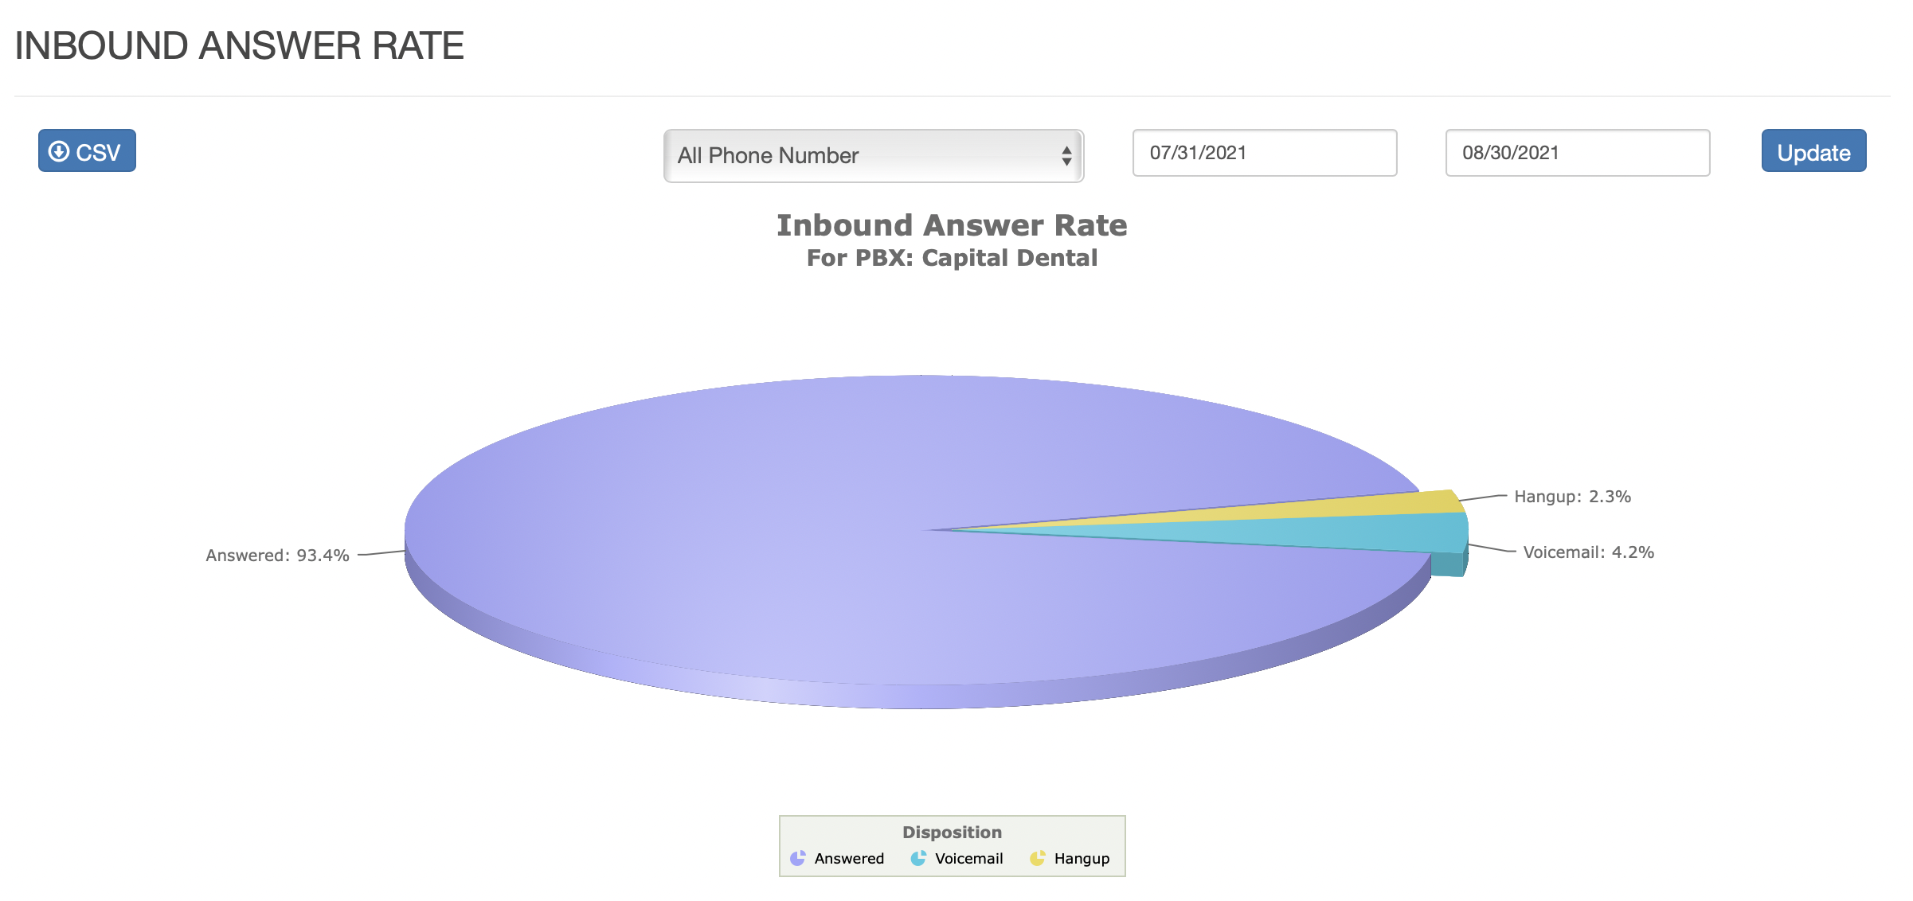
Inbound Phone Answer Rate

Slide 9
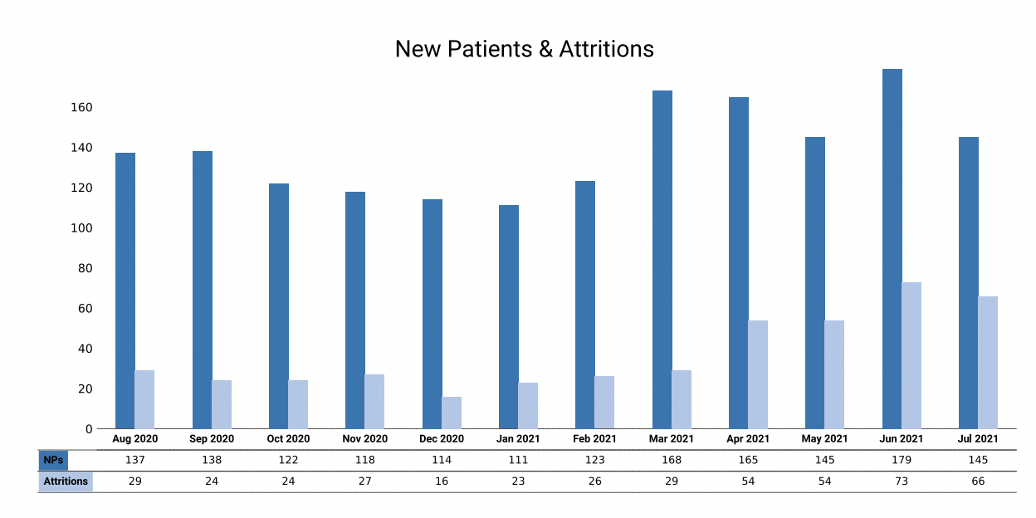
Attrition Vs. New Patients
Attrition is Any patient not seen in the last 18 months
New Patients

Slide 10
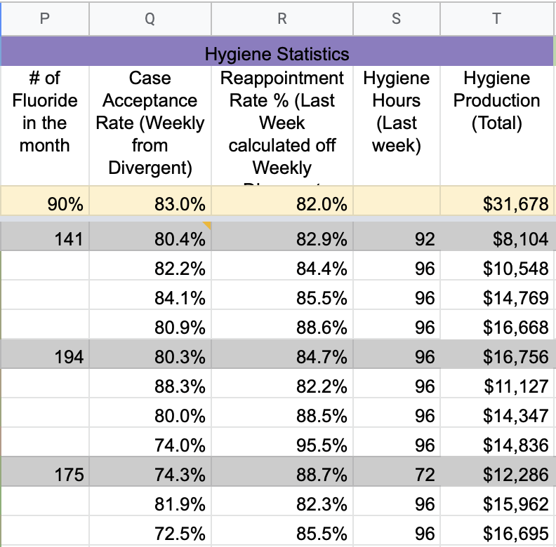
Hygiene Department Weekly Indicators

Slide 11
Case Acceptance Rate
Case Acceptance by $$$
  You Treatment plan $50,000….and Patients accept $25k…..then you’re at 50%
Case Acceptance by Patients
  You treatment plan $50,000 between 10 patients
  1 Case was $40,000….the others all added up to $10,000 Total
  The other 9 accept --> then you have a 90% Case Acceptance by Patients

Slide 12

Hygiene Goals
Goal is to always have Hygiene Produce 3.3 X Their Hourly wage
So if their hourly wage is $40…..then $132 in Collection/Production per hour is the goal

Slide 13
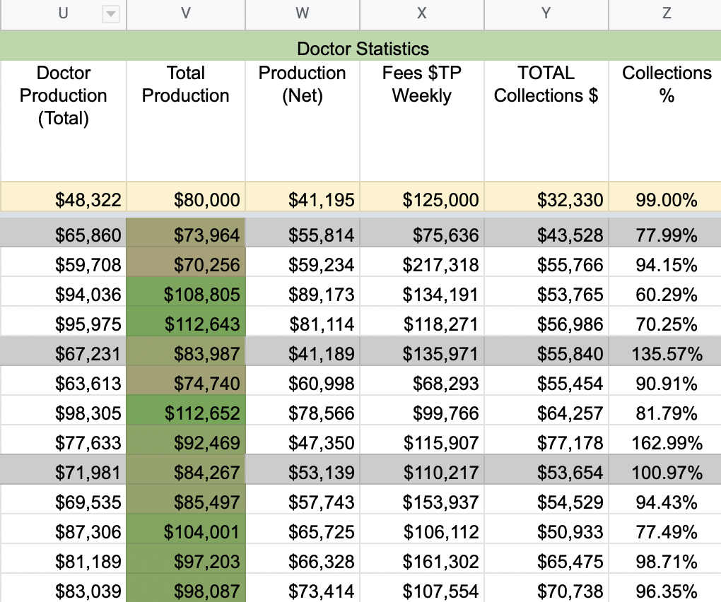
Doctor Department Weekly Indicators

Slide 14

Treatment planning Statistics
Average Treatment acceptance rate by patients – 60-90%
Average Treatment acceptance rate by dollar – 25-45%

Slide 15




Collections %
SHOULD ALWAYS BE BETWEEN 97-99%
OVER 100% CAN HAPPEN IN SHORT BURSTS OF TIME
THE LONGER THE HORIZON, THE MORE ACCURATE THE NUMBER
BELOW 95% AND YOU HAVE A COLLECTIONS PROBLEM

Slide 16
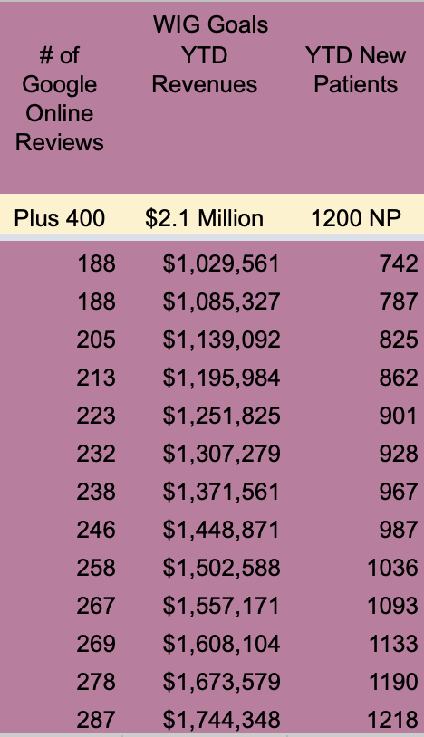
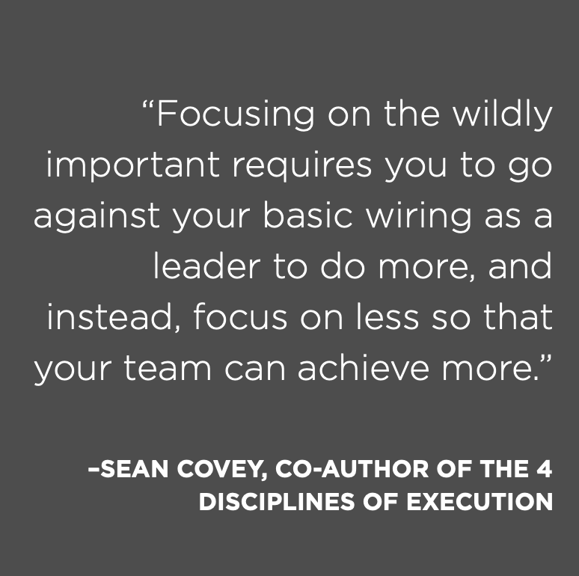
WIGs

Slide 17
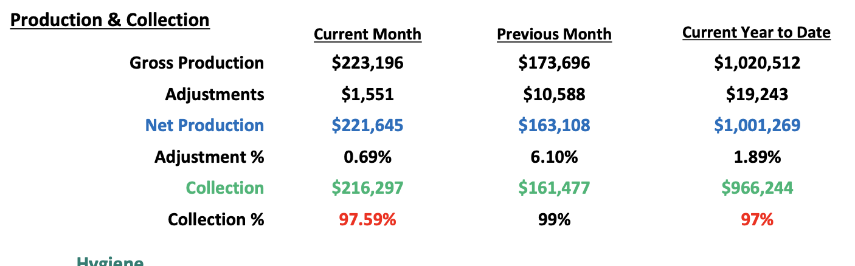

Slide 18
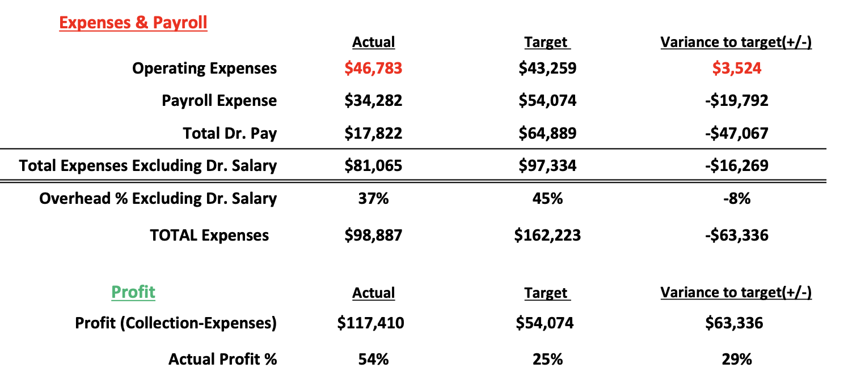

Slide 19
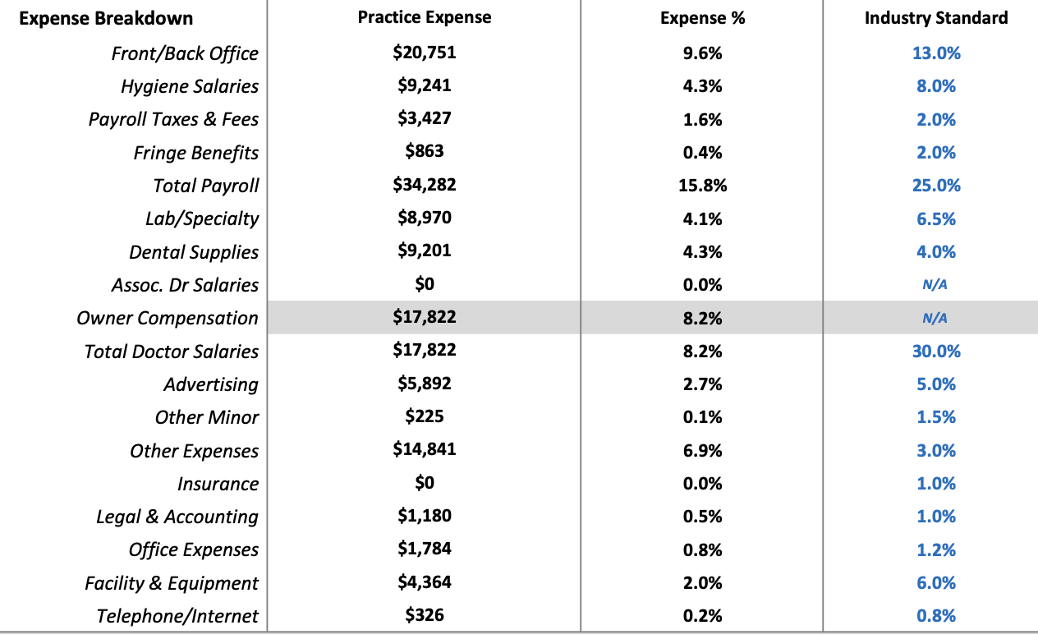

Slide 20
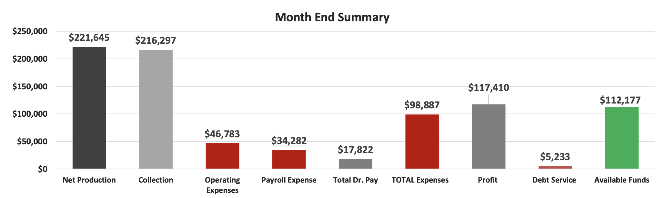
What is ‘Profit’?

Slide 21
2 Big Questions:
Where do I start with Systems?
What can I do to become a better business owner?

Slide 22
Where to start?
Remember, you are pulled in 2 directions…
Clinical
Front Office

Slide 23
Clinical
Patient Management
Extractions
Endo
Implantology
Crown & Bridge
Occlusion
Sleep Devices
Perio

Slide 24
Front Office
Hiring and Firing
Cash Flow Management
Collections
Insurance Negotiations
Marketing
Payroll
Human Resources

Slide 25
How do you balance everything?
Clinical
Business
HR
Extractions
$$$
Pt. Mgmt
Marketing

Slide 26
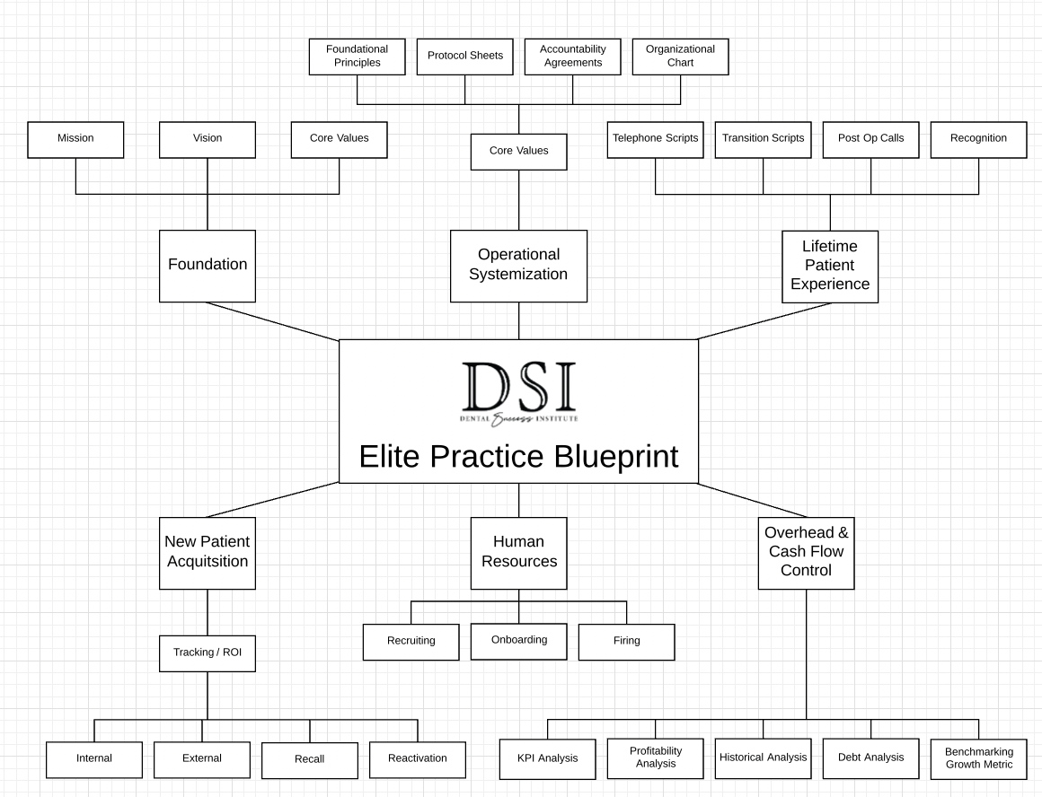
Systems

Slide 27
Basics of Business
Follow the Patient Exercise vs. Follow the Dollar Exercise
  Website Search
  Phone Call
  Online Scheduling
  Greeting Pt. at Front Desk
  Getting Patient from Waiting Room
  Office Tour
  Seating Patient
  Intro to Doctor (Relationship Building)
  Checking in on Patient
  Checking out in Room or Treatment Presentation
  Appointment Wrap up
  Review Follow Up

Slide 28
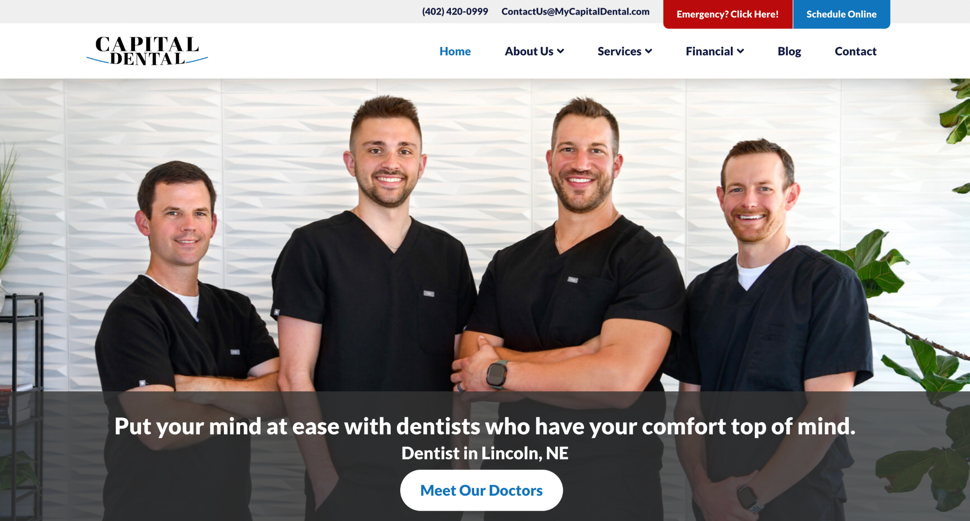
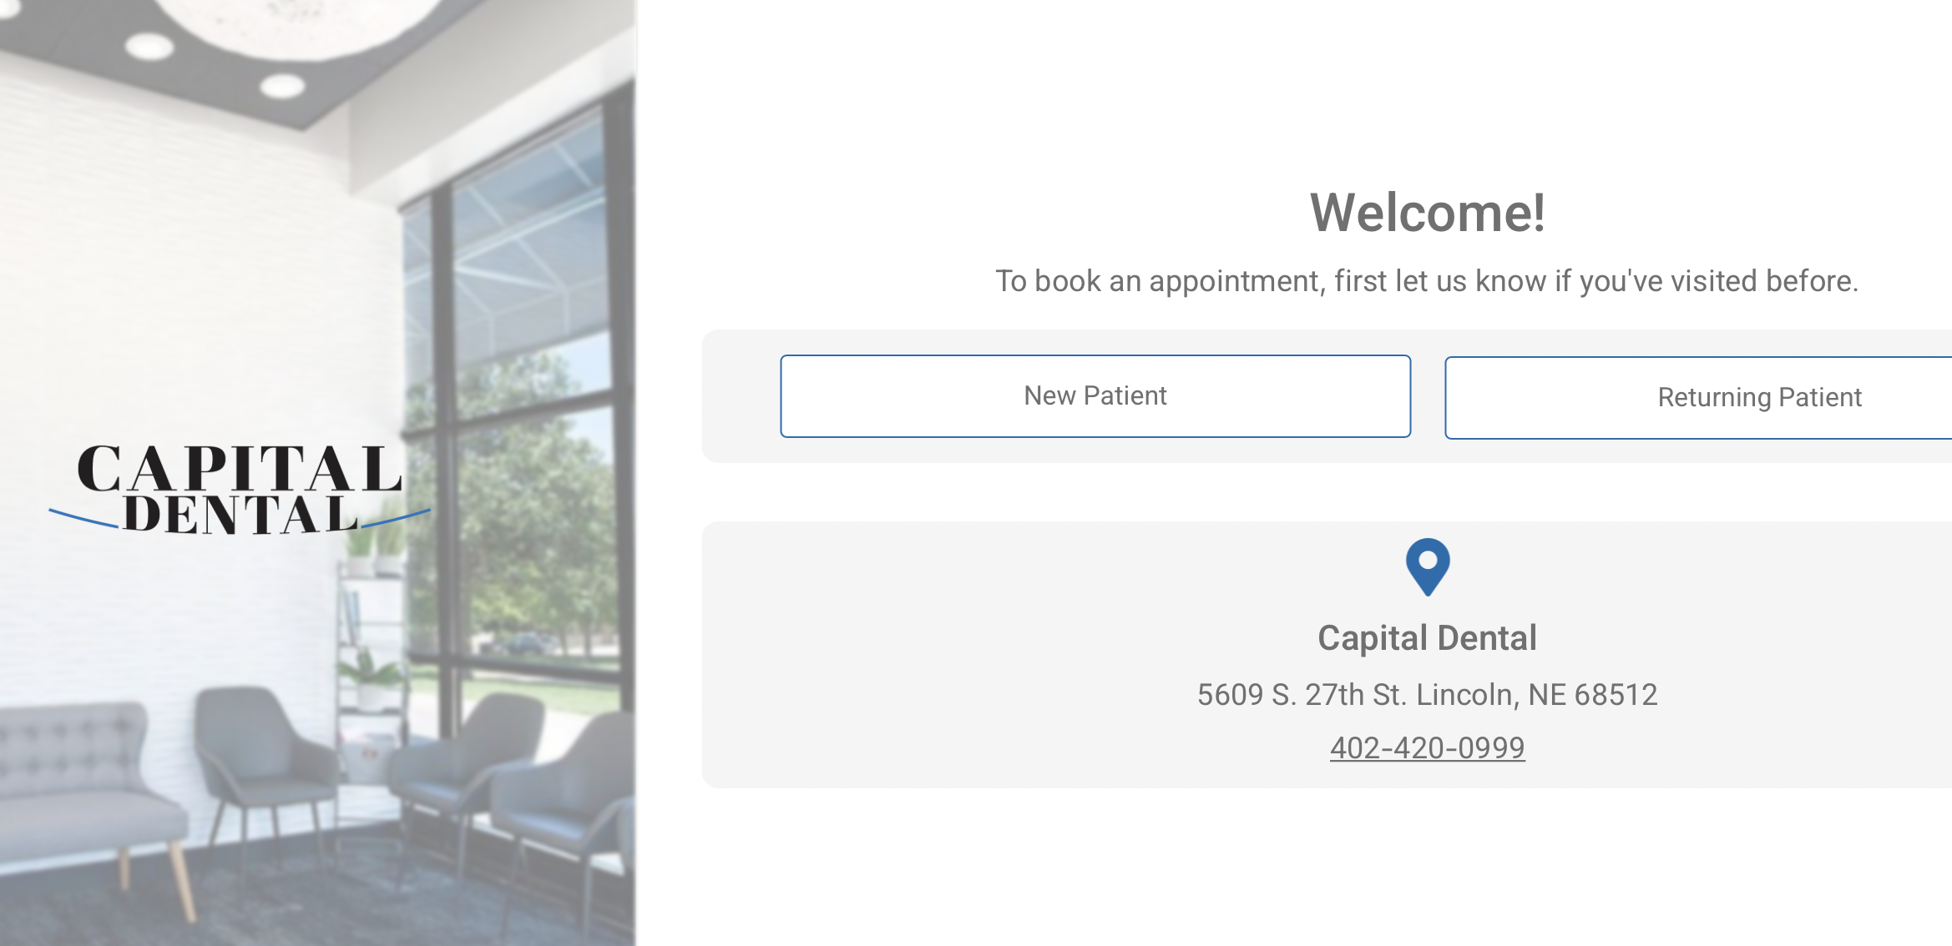
Website Search and Online Scheduling

Slide 29
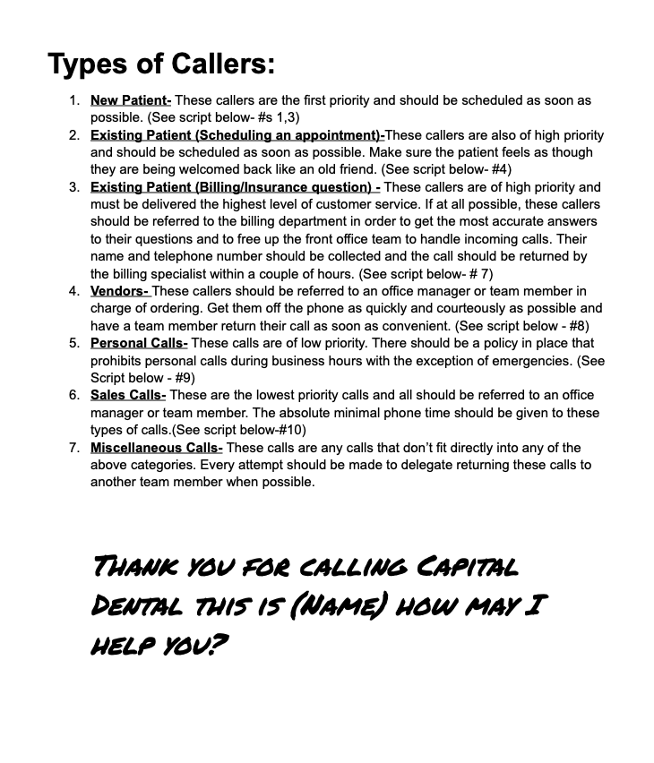
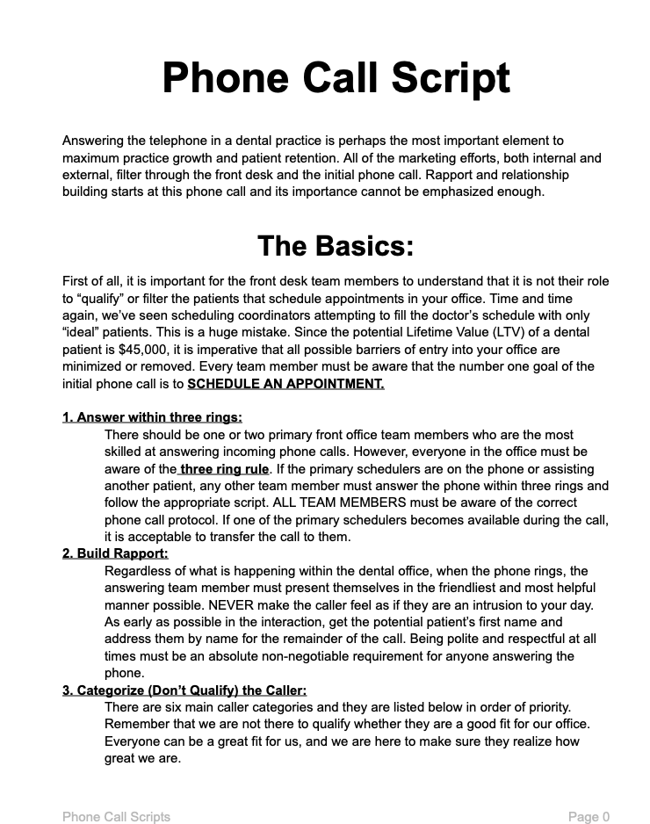
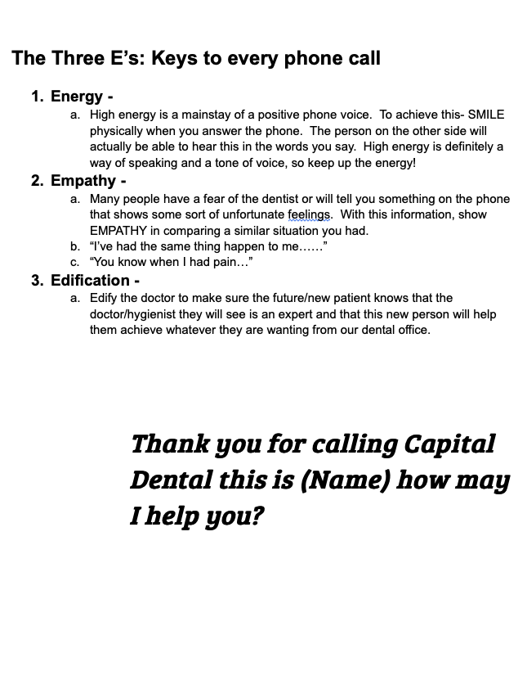
Phone Calls

Slide 30
Greeting Patient at Front Desk
What exact script to use to greet patient?
Body Language- do you stand up to greet?
What information to collect?
How do you balance phones and patients?

Slide 31
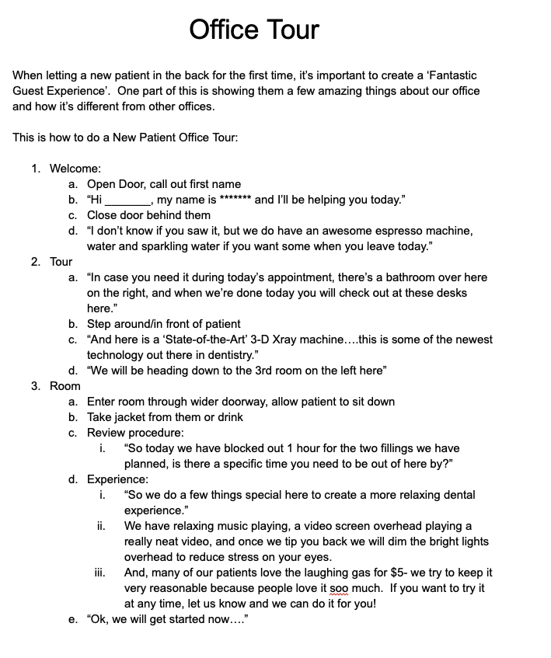
Waiting Room 🡪 Operatory
Office Tour – Script
Seating Patient – making them comfortable

Slide 32
Transfer of Trust
Front 🡪 Assistant
Assistant 🡪 Doctor
Doctor 🡪 Treatment Coordinator

Slide 33
Meeting the Doctor
Ask 3 Non-Dental Questions
Always check on patient during procedure at least 3 times
Cialdini’s Principles – 6 Principles of Persuasion
  Find something you like in that person
  Find something you have in common

Slide 34
Checking Out
Estimated Patient Portion due today
  Estimated from System or from Treatment Coordinator
  Use correct scripting to allow patient to pay
Coordinating Future Treatment
  Either Hygienist, Assistant, or Treatment Coordinator can discuss ‘Estimated Patient Portions’
  Print out for patient, schedule patient
  They know EXACTLY what they owe, and how it will be done for future appointments

Slide 35
NDTR
Next Visit
  “So next up we need to get that Crown on #3”
Date Range for Treatment
  “We should really get to that quickly in the next 2 weeks”
Time allowed for Treatment
  “The entire appointment will take about 60 minutes”
Recall Rescheduled
  ”And then it looks like we already have your next cleaning scheduled in August”

Slide 36
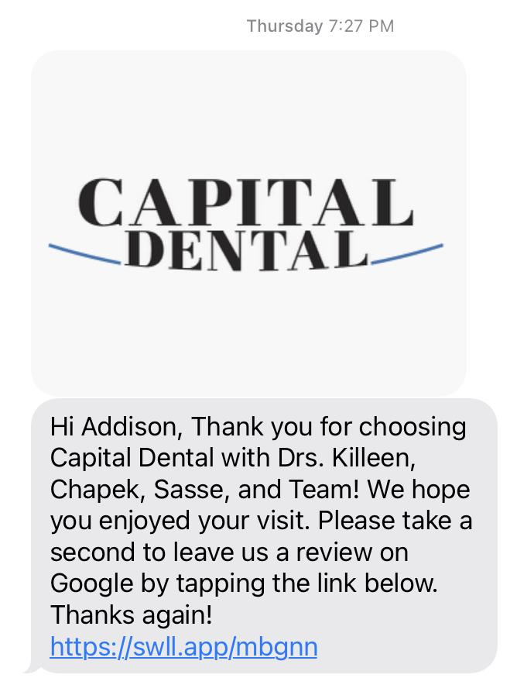
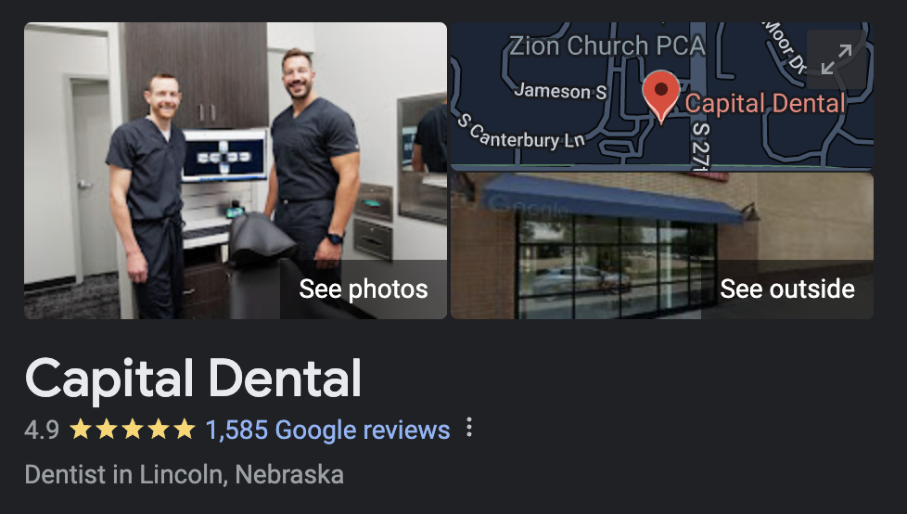
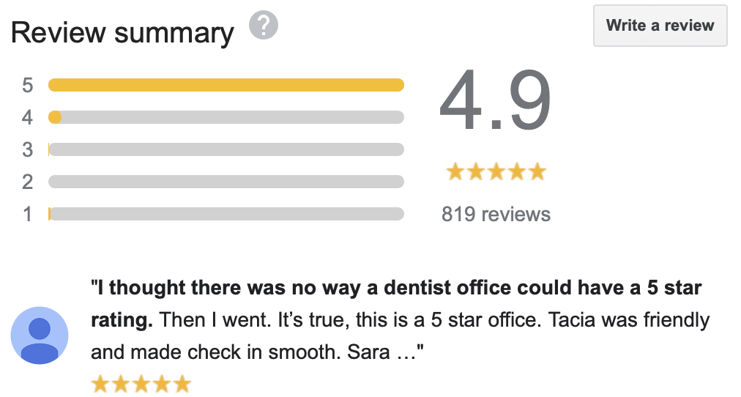
Asking for Reviews
Automated Software that Texts patients afterwards

Slide 37
Follow the Patient
Call
Set up Next Visit
Schedule
Collections
Experience

Slide 38


Slide 39
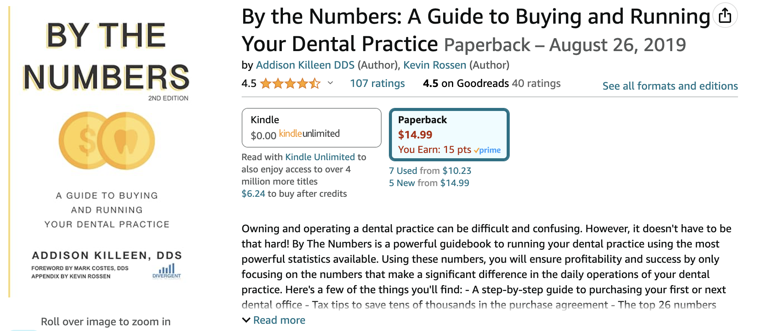
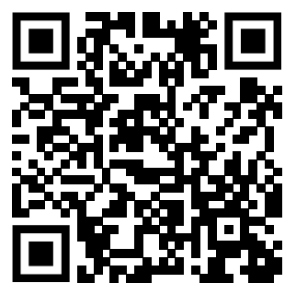
Scan the QR code, enter your email address, get downloadable documents, and once you are in my list, you will receive a free copy of my bestselling book, By The Numbers.
Next week, I will order a box of books to have delivered to the school for all of you who put your name in.

Slide 40
Thanks!

